Slide 1

Your Blockchain Adventure
Or: How You shall learn to Stop Worrying and Love the Blockchain

Slide 2
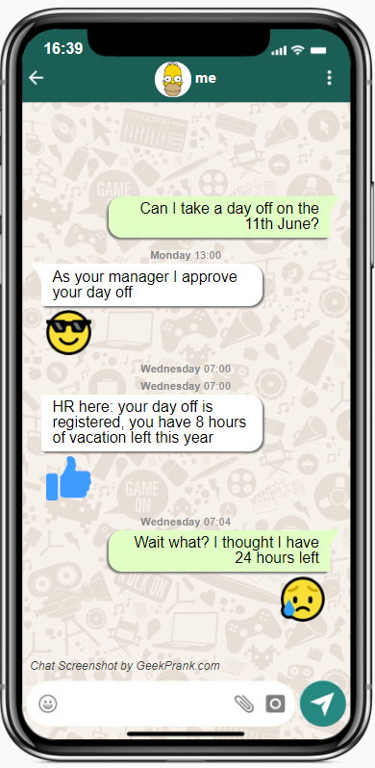
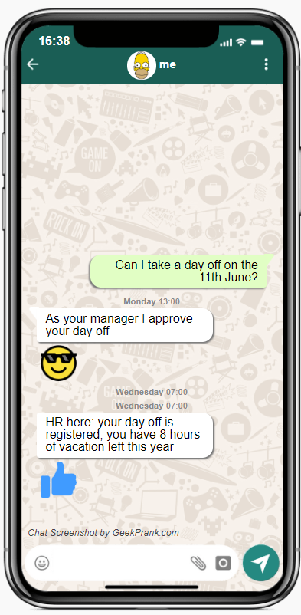
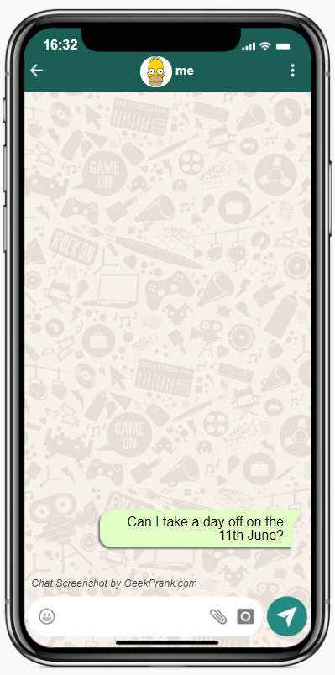
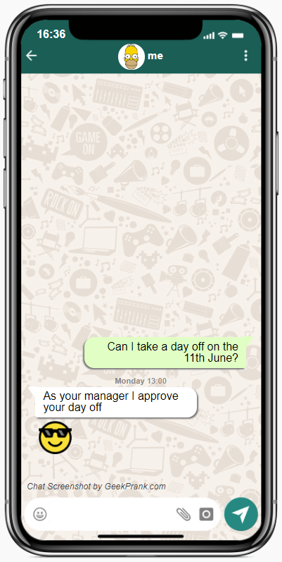

Time for holidays!

Slide 3
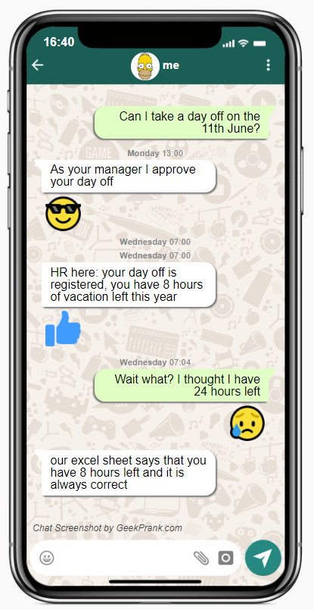


Slide 4

Why
are You here?
You are curious about Blockchain
You like going on vacation
This Photo by Unknown Author is licensed under CC BY-SA

Slide 5
What does Blockchain and Vacation have in common?

Slide 6

What does Blockchain and Vacation have in common?
What are you talking about?

Slide 7

What does Blockchain and Vacation have in common?
We shall use it in our company

Slide 8

What does Blockchain and Vacation have in common?
You changed my what?

Slide 9
What to expect from today's session
When and why to use a Blockchain
How Blockchain works with Microsoft PowerPlatform

Slide 10
Ledger
What is a Blockchain?
Distributed
Immutable
Trust

Slide 11

Decentralised finance
Fair trading
Auditing
Cryptocurrency
Supply chain monitoring
Digital Ids
Digital Voting
Intellectual Property rights
Tax regulation
Weapons tracking
Medical Record keeping
Real estate transfer
Loyalty cards
Vacation request
…………place your idea here
I have 3 million reasons to use a Blockchain. Try and find them all!

Slide 13
Where does the Traditional process fail?
Central Authority – can I trust it?
Central Store – is it secure?
Multiple copies –
What if I don’t agree?

Slide 14
Who owns your holiday hours?

Slide 15



How much are your holiday hours worth?

Slide 16
Would you trust a stranger with your money and no accountability?

Slide 17
Would you trust a stranger with your money and no accountability?
You need a Contract

Slide 18

Modern process – VAC token

Slide 19
What’s new with the modern process?
Holidays are truly yours
Single point of truth
Many witnesses

Slide 20
PowerApp
Demo

Slide 21
Blockchain explorer
Demo

Slide 22
Infrastructure

Slide 23
The contract

Slide 24
The contract

Slide 25
The contract

Slide 26
The contract

Slide 27
The contract

Slide 28
The contract

Slide 29
The contract

Slide 30
How the Powerapp was built (connector, ABI, network)
Demo

Slide 31
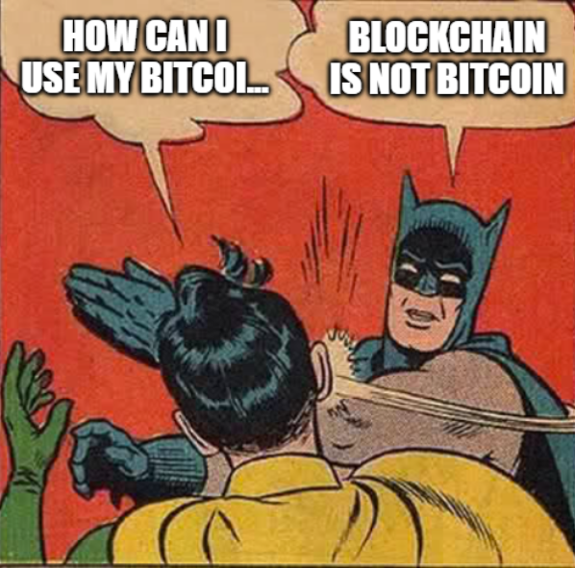
Question time!

Slide 32
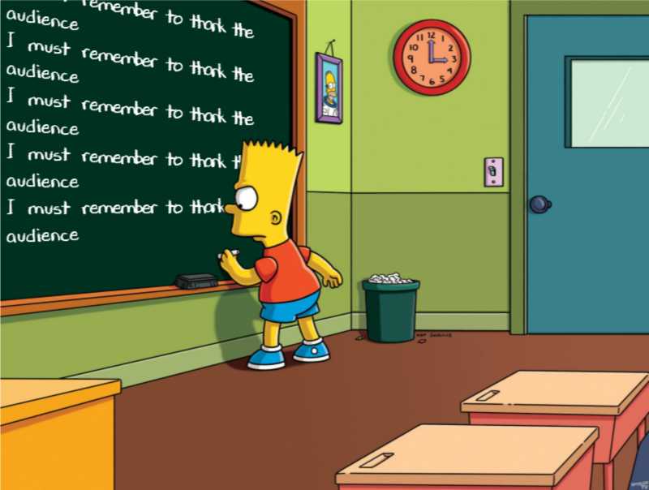

Slide 33
Links/References

